Slide 1
Patient to Patient
Shared Experiences

Slide 2
Michael Mangan
Married with 3 children
Diagnosed E.S.R.F 1994 started dialysis
Kidney transplant 1995 Failed 2000
Back on dialysis 2000
Triple bypass 2002
Kidney Transplant 2002

Slide 3
What it’s all about
What is Patient2Patient?
A free support service where patients diagnosed with E.S.R.F. can discuss their condition, feelings and treatment with fellow patients who have already been through the experience.
Knowledge empowers the patient, it’s not knowing that inhibits you.

Slide 4
Why ?
“There is no other area in medicine where the patient is part of the medical team,
The patient needs to be informed and involved in all stages of the process” David Hickey.

Slide 5
How P2P will operate
One to One support
Group meetings
Online support
Dedicated support phone line

Slide 6
Case Study
Patient - x
Female age 58 years
4 years on dialysis
3 years on Transplant list
Isolation / loneliness / fear / lack of communication
“Talking to a fellow patient helped me greatly”

Slide 7
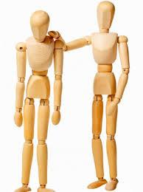
Isolation
Everything seems worse when faced alone
“I dont have to imagine what you’re going
through...I know”

Slide 8
Patient2Patient
Patient2Patient is a nonprofit, Patient-focused, Patient-run organization, that provides non-medical advice to those affected by chronic kidney disease .

Slide 9
Similar Services
RSN established in 1993 in U.S.A
Nephrology news U.S.A
Kidney Patient guide UK

Slide 10
Light at the end of the tunnel
There's always light
at the end of the tunnel.

Slide 11
Our Goal
To improve the lives of fellow patients.
To help patients cope after diagnosis and face their treatment with a positive attitude

Slide 12
A patient fully involved in the process guarantees a better outcome.
Patient2Patient Shared Experiences
is a valuable resource for doctors, nurses,
counsellors, and patients

Slide 13
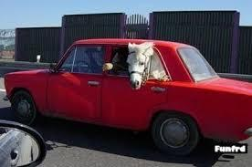
3 hours Late for dialysis
A funny thing happened
on my way to dialysis...

